Slide 1
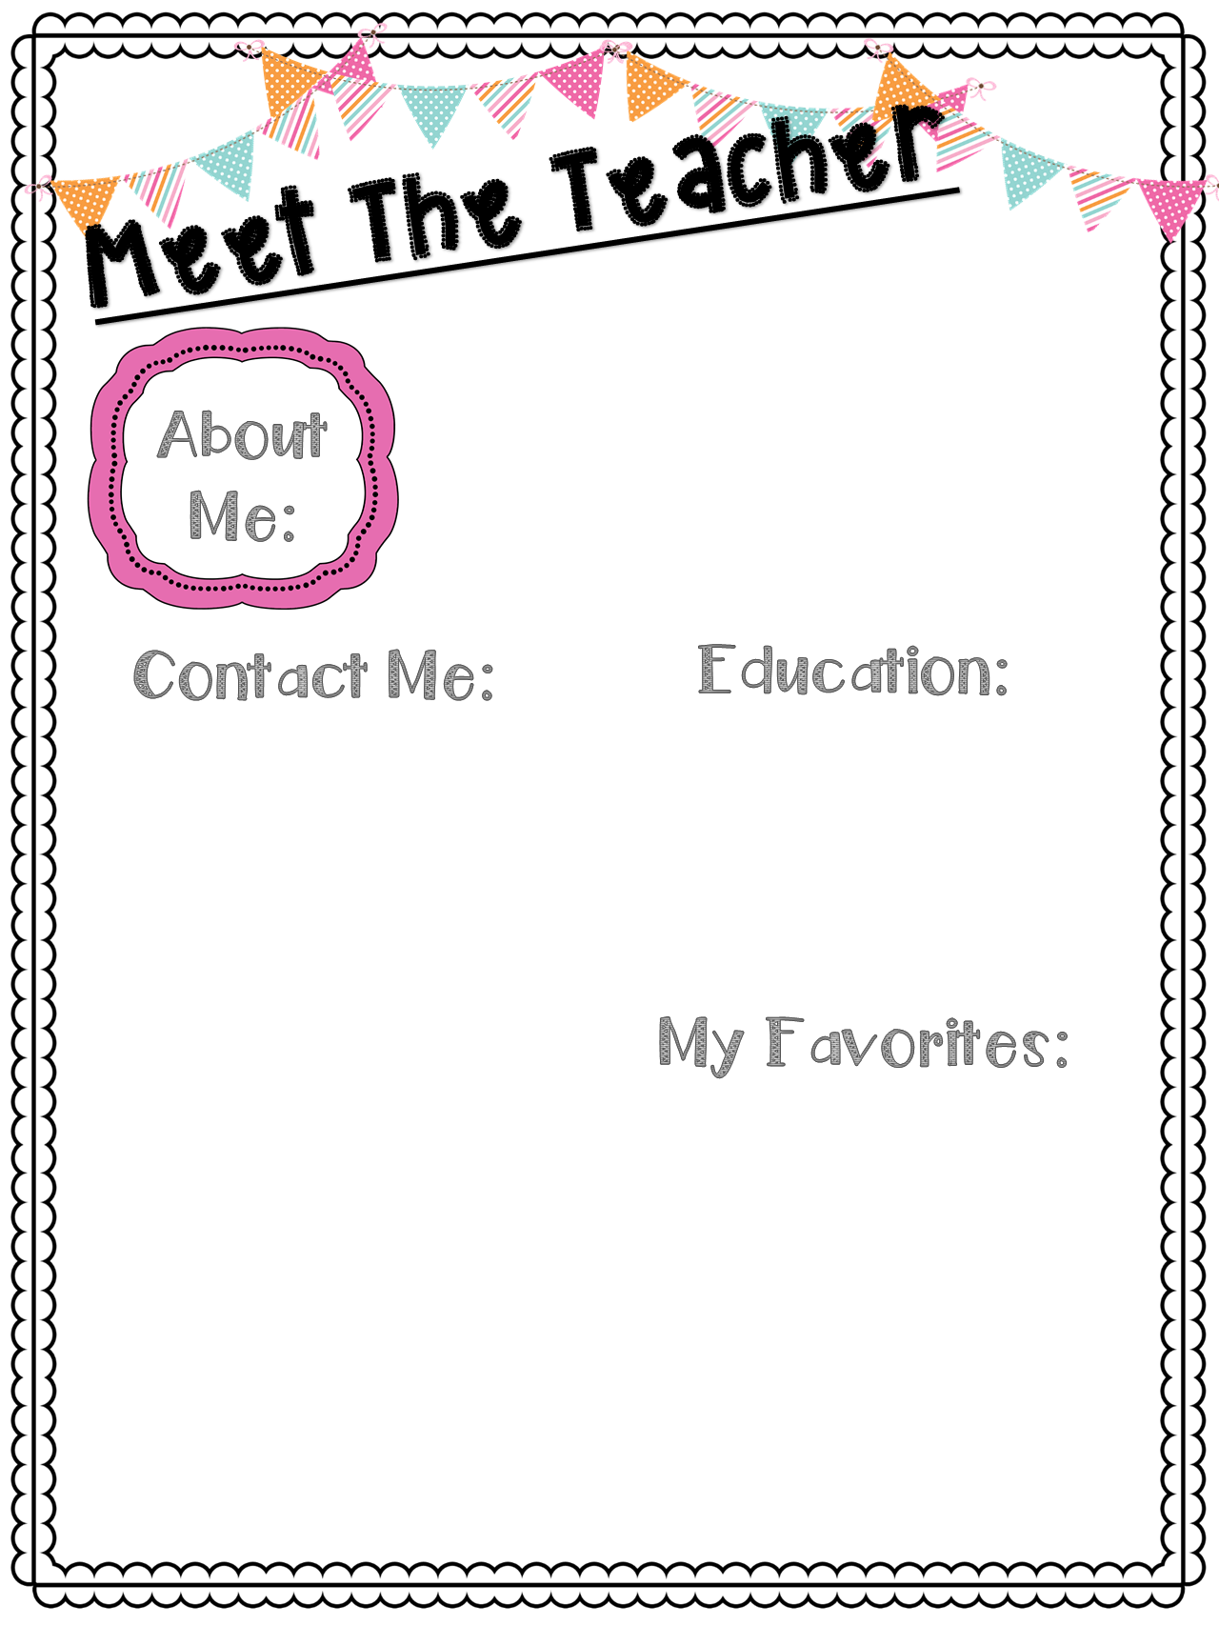
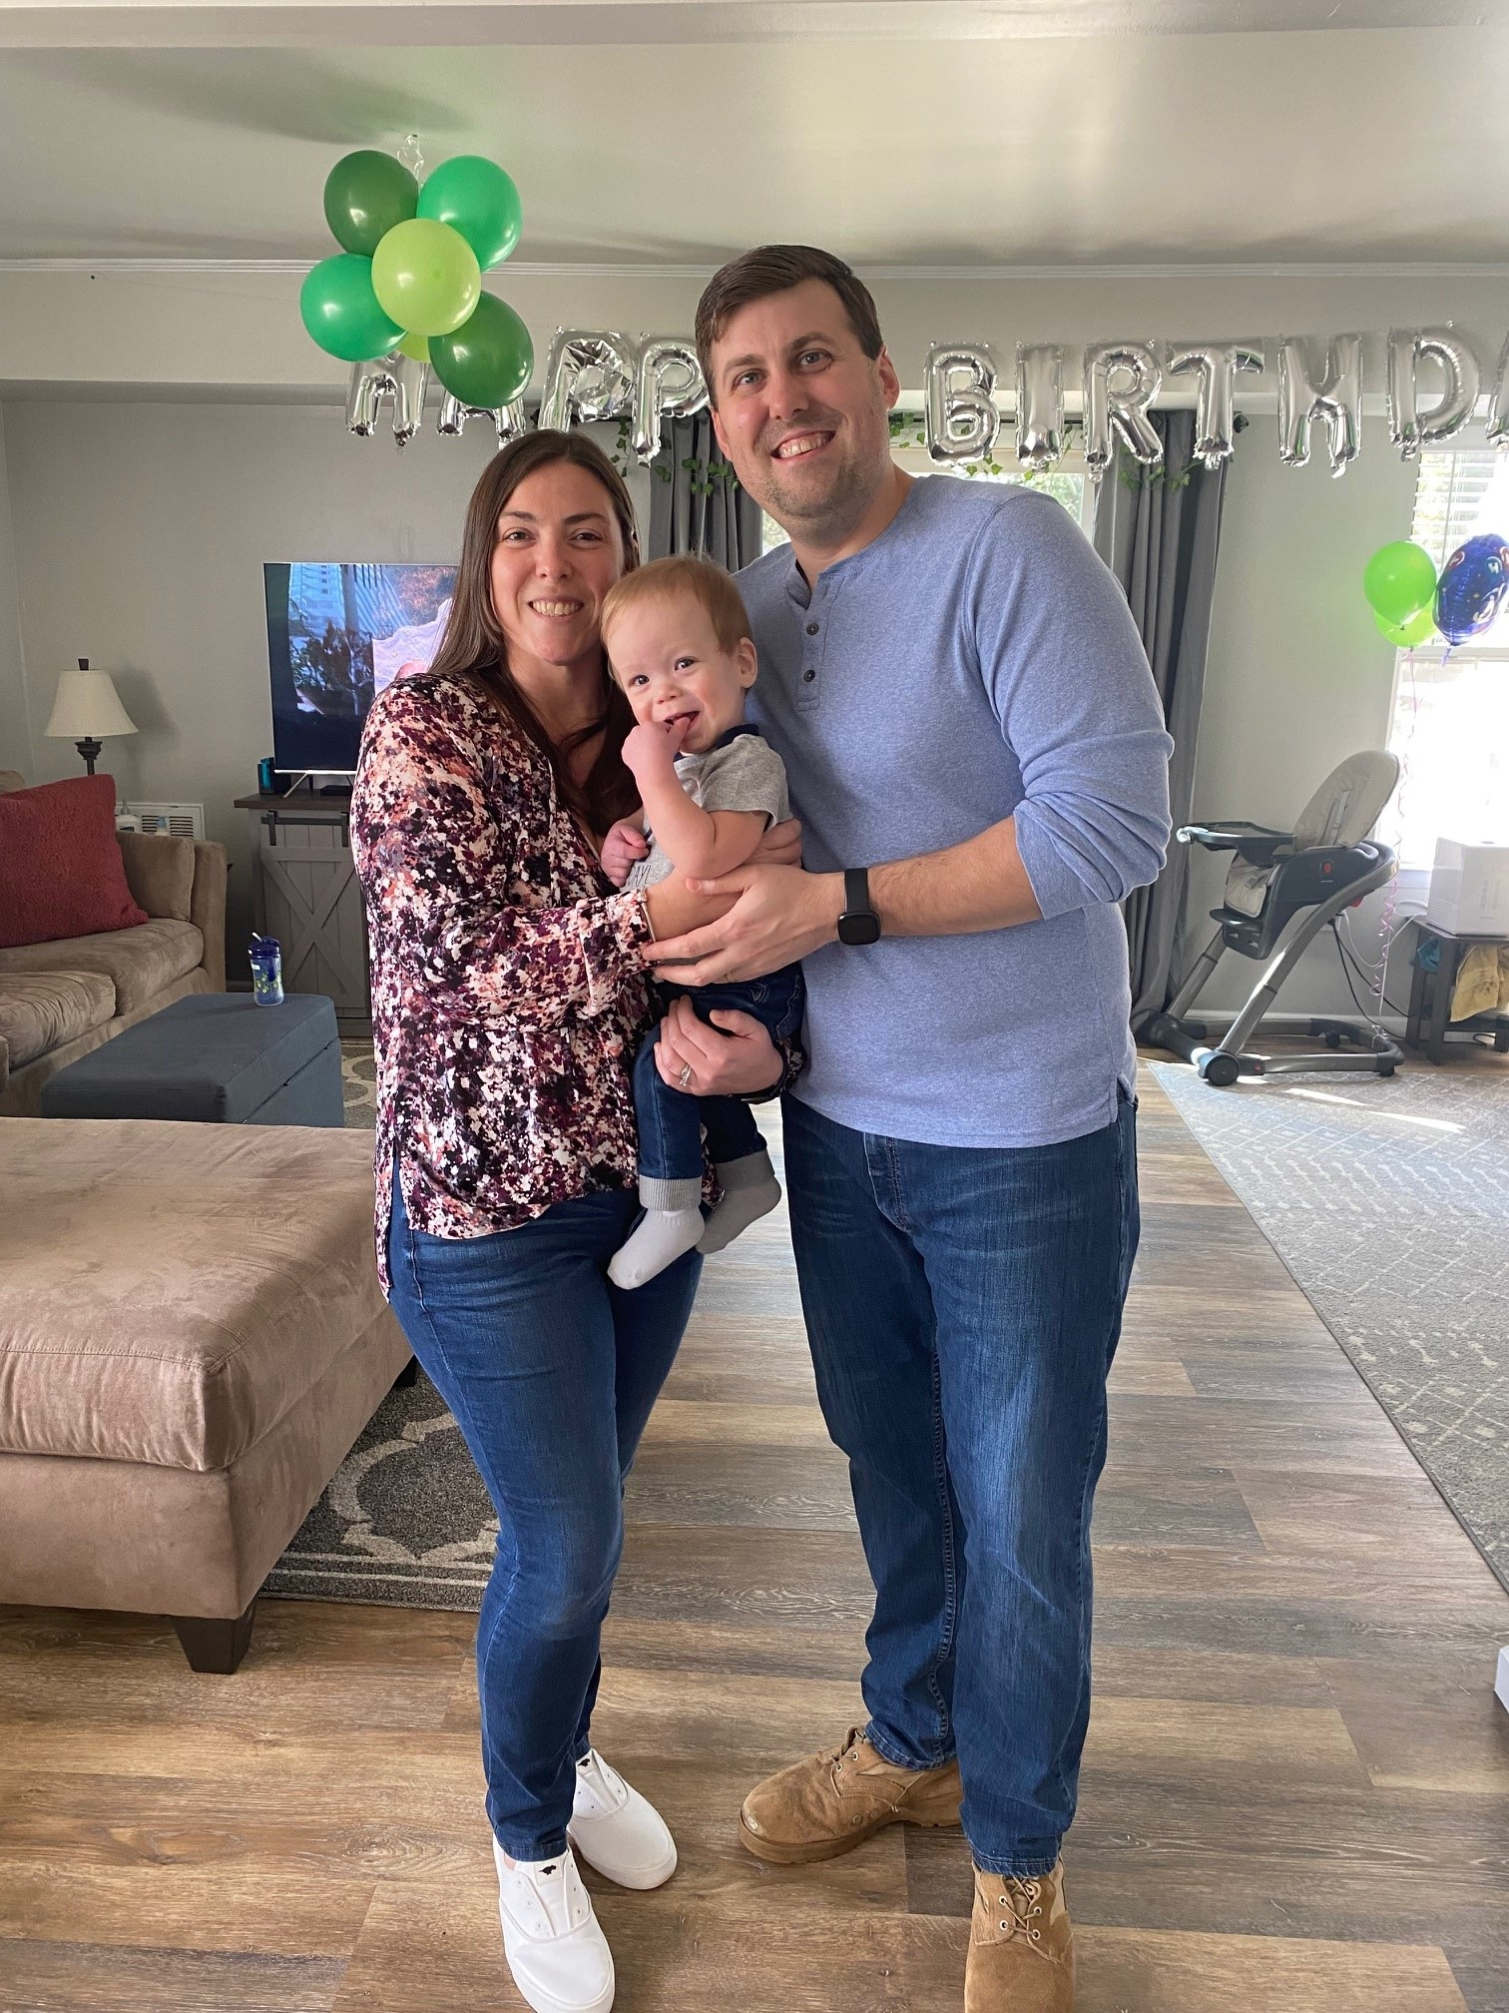
Mrs. Fisher
Hello, I am excited to be your 6th grade teacher! I have been at Pine Run since 2014 and started with Kindergarten & 2nd grade. This will be my 13th year teaching and my 8th year in 6th grade! My husband and I live in Bedminster with our son Ryan and our dog Rocky! We love to travel and be outside! Family time is the best!
I love to hear from parents. Please contact me with questions or concerns.
☺
cfisher@cbsd.org
267-893-4450
Ext. 1799
I went to Temple University (go Owls!) for my undergraduate in Elementary and Early Childhood Education. I received a Masters of Education from La Salle University.
Store: Target
Food: All of it!!!
Hobbies: Reading, Gardening, Running
Candy: Anything gummy!
Restaurants: El Limon & Arianna's
Flower: Daisies
Season: Fall
Sport: Baseball
Subject: Math

